Slide 1
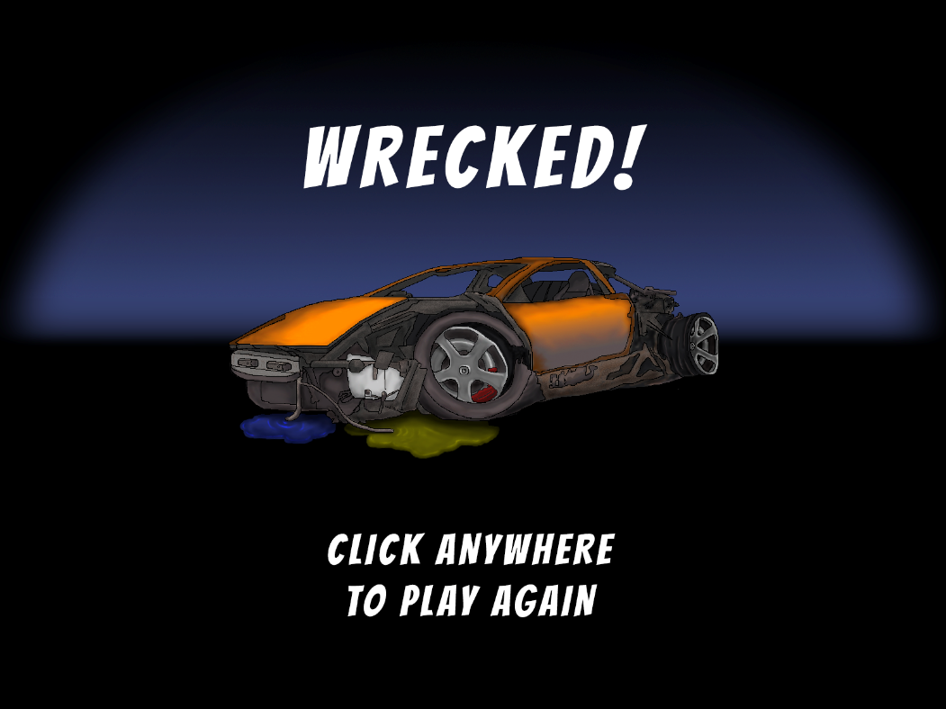
Little Racers
Pitch Date: June 22 , 2019 Week 9: 9/1/2019
Release Date: September 15, 2019 2 weeks to go!
Team Lead: Vince McKeown
21 contributors
421 total commits!

Slide 2
Updates
Vaan
Fixed Rest and Rocket collision
Vince McKeown
Added Rockets and collisions
Level 1
Christer “McFunky Pants” Kaitila
Added Headlights
Simon
Refactored Game States
Added Wrecked Game State
Ricardo Velez
Cars now slide on ice
Jeff Hanlon
Added Half sized wreck screens

Slide 3

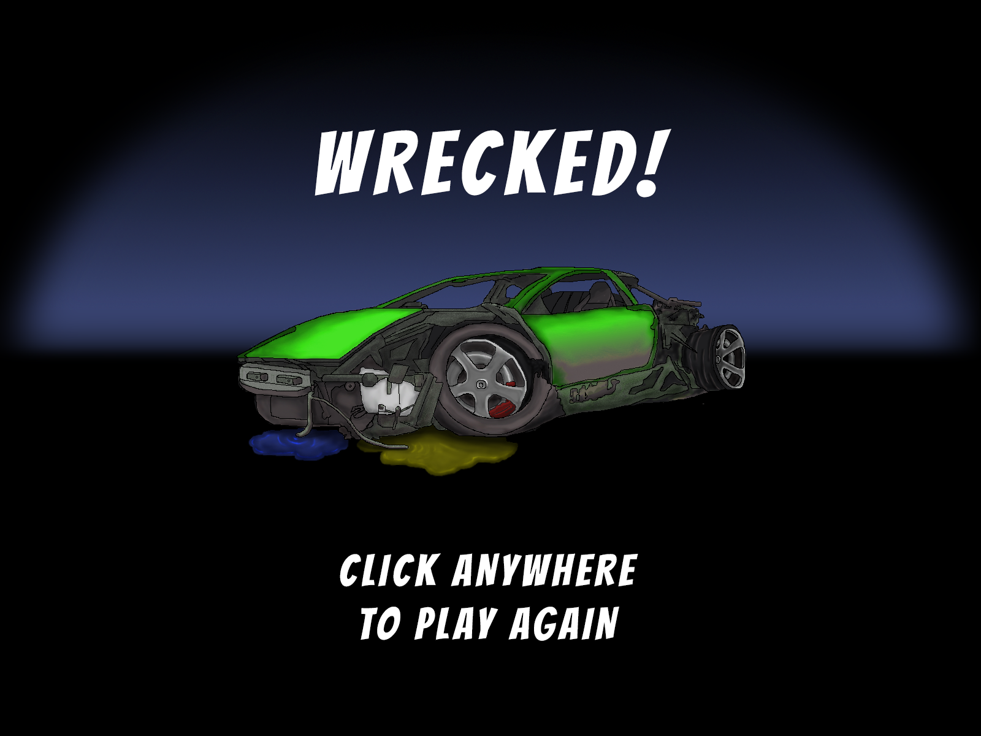


Updates to Art
Justin Horner
Vince McKeown
One for each car
Vince McKeown
Jeff Hanlon

Slide 4
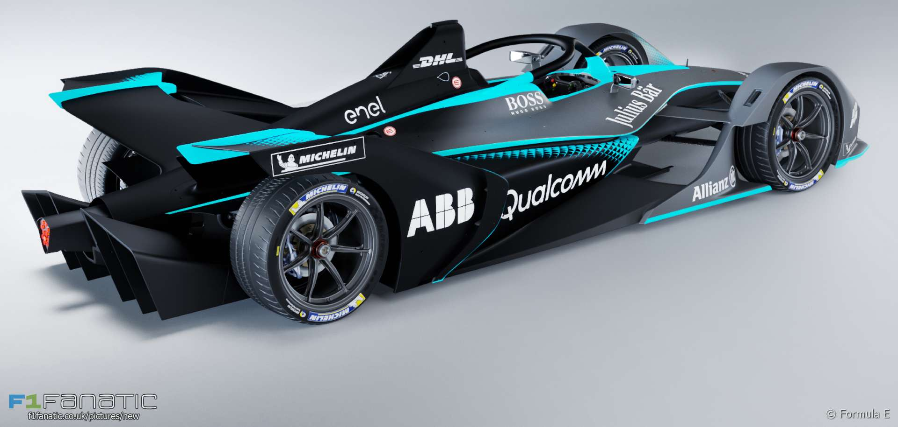
Demo
Cutover to Game

